Slide 1
A parallel content-based image retrieval system using apache spark and alluxio frameworks
19BCE1328 - Sanika Kulkarni
19BCE1295 - Tejas Vaichole
19BCE1614 - Sandhya S
Notes:
© Copyright PresentationGO.com – The free PowerPoint and Google Slides template library

Slide 2
Technologies Used
Apache Spark
Alluxio
Notes:
© Copyright PresentationGO.com – The free PowerPoint and Google Slides template library

Slide 3
Abstract
With the large increase of large-scale transmission of data over Internet, particularly pictures, building Content-Based Image Retrieval (CBIR) systems for large-scale images has become an enormous challenge. One amongst the drawbacks related to CBIR is that the terribly long execution time. This paper to proposes a Fast Content-Based Image Retrieval system using Spark (CBIR-S) targeting large-scale images.
Notes:
© Copyright PresentationGO.com – The free PowerPoint and Google Slides template library

Slide 4
This system consists of 2 steps:
(i) Image regulating step, uses MapReduce distributed model on Spark to increase the speed of indexation process. We have used a fast memory-centric storage system, known as Alluxio. The indexing step is parallelized using MapReduce model on Spark which works on distributed computing. HOG (Histogram of Oriented Gradients) method is used for feature extraction.
(ii) Image retrieving step speeds up by employing a parallel k-Nearest Neighbors (k-NN) search methodology which supports a MapReduce model implemented under Apache Spark.

Slide 5
Apache Spark
Apache Spark is an open source distributed processing system used for big data.
It is based on the Hadoop MapReduce model used for large-scale data processing.
So spark is faster than other computational models. Extend MapReduce problems to more types of computations, including interactive queries and streaming.
Various CBIR studies have shown that Spark helps increase search times when compared to other systems.
For this reason, Apache Spark is preferred for computational purposes.

Slide 6
Alluxio
Alluxio, formerly known as Tachyon, is a virtual distributed storage system. Bridging the gap between data-driven applications and storage systems.
Bridging the gap between data-driven applications and storage systems.
It can also be used as a distributed shared caching service, allowing computing applications that interact with Alluxio to transparently cache frequently accessed data, especially from remote locations, providing in-memory I/O throughput.
In addition, Alluxio’s tiered storage that can use both memory and disk (SSD/HDD) makes scaling data-driven applications cost-effective.

Slide 7
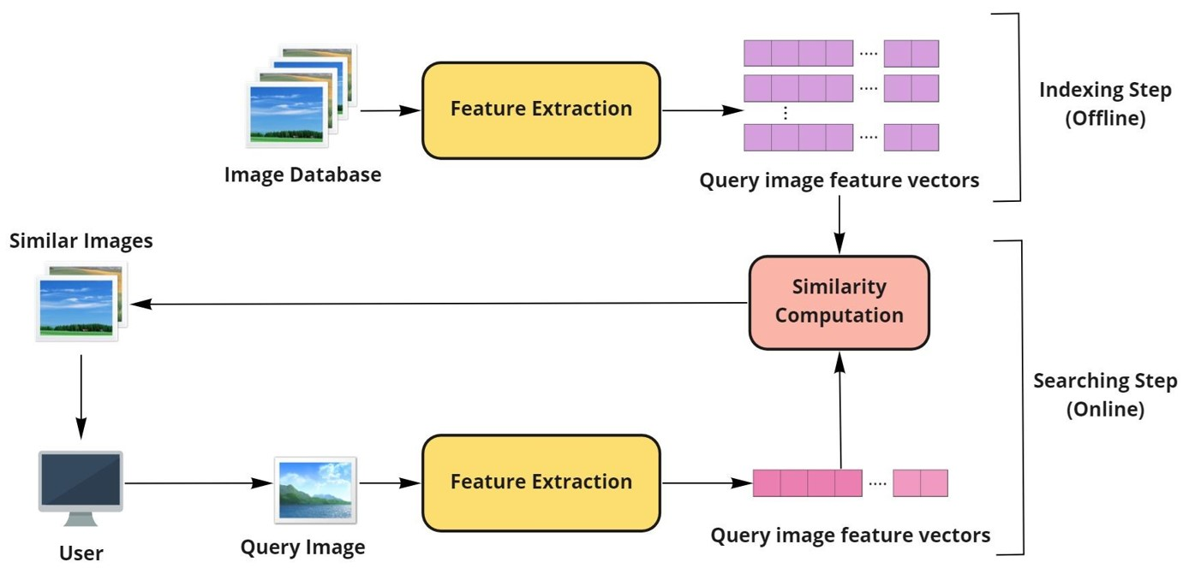
Overall architecture

Slide 8
Indexing Step:
Indexing is an offline step which is not performed during the retrieval of similar images. In this step, the features are extracted from the database images and stored in the storage system. To extract the features the images are first stored in the alluxio in the sequence file format.

Slide 9
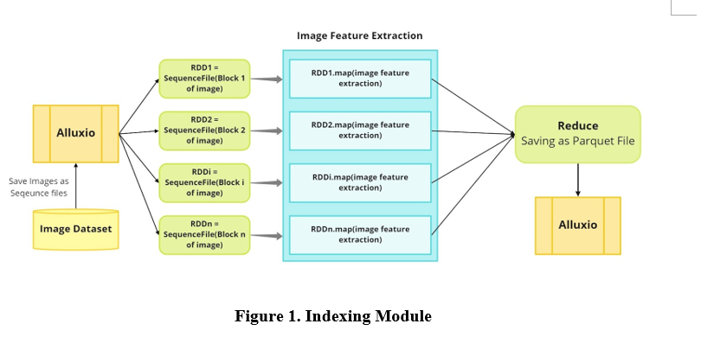

Slide 10
SEARCHING STEP
This is an online step where similar images are extracted based on the extracted features. Query image is first taken as input from the user.
From the query image the HOG features are extracted using the same method used for extracting features from database images.

Slide 11
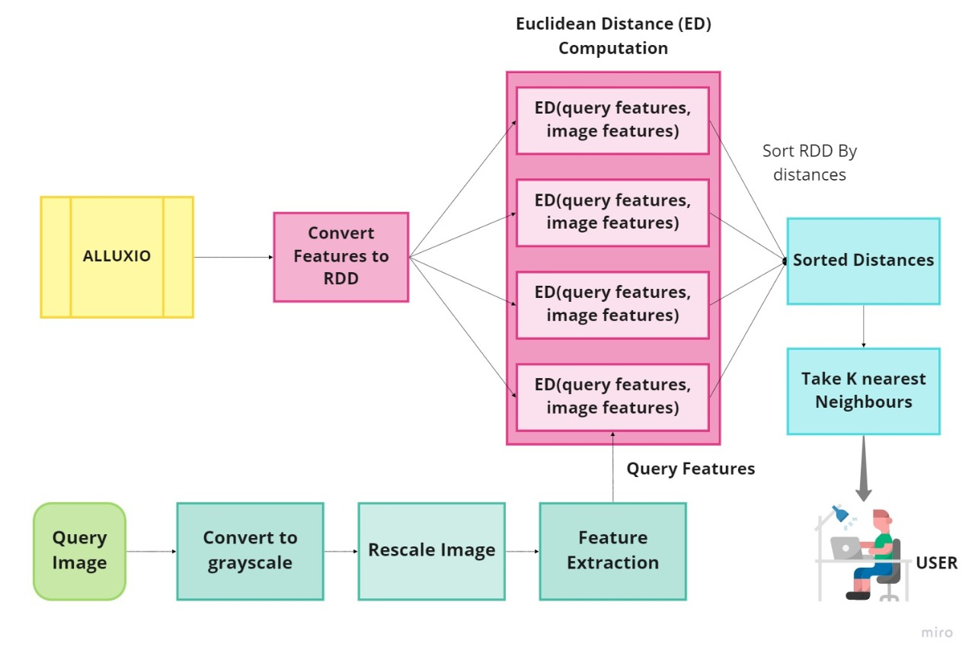

Slide 12
Base Paper URL
https://www.sciencedirect.com/science/article/pii/S1319157818307146

Slide 13
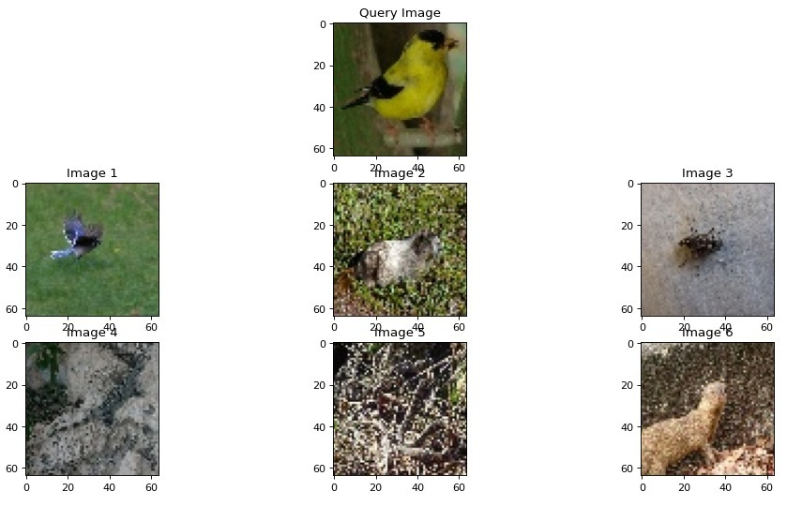
Outputs

Slide 14
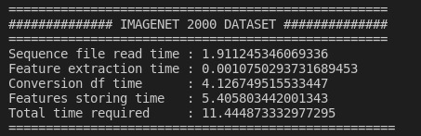
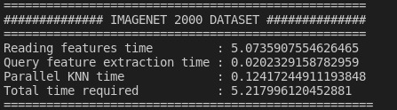

Slide 15
Thank You!
Notes:
© Copyright PresentationGO.com – The free PowerPoint and Google Slides template library

